Slide 1




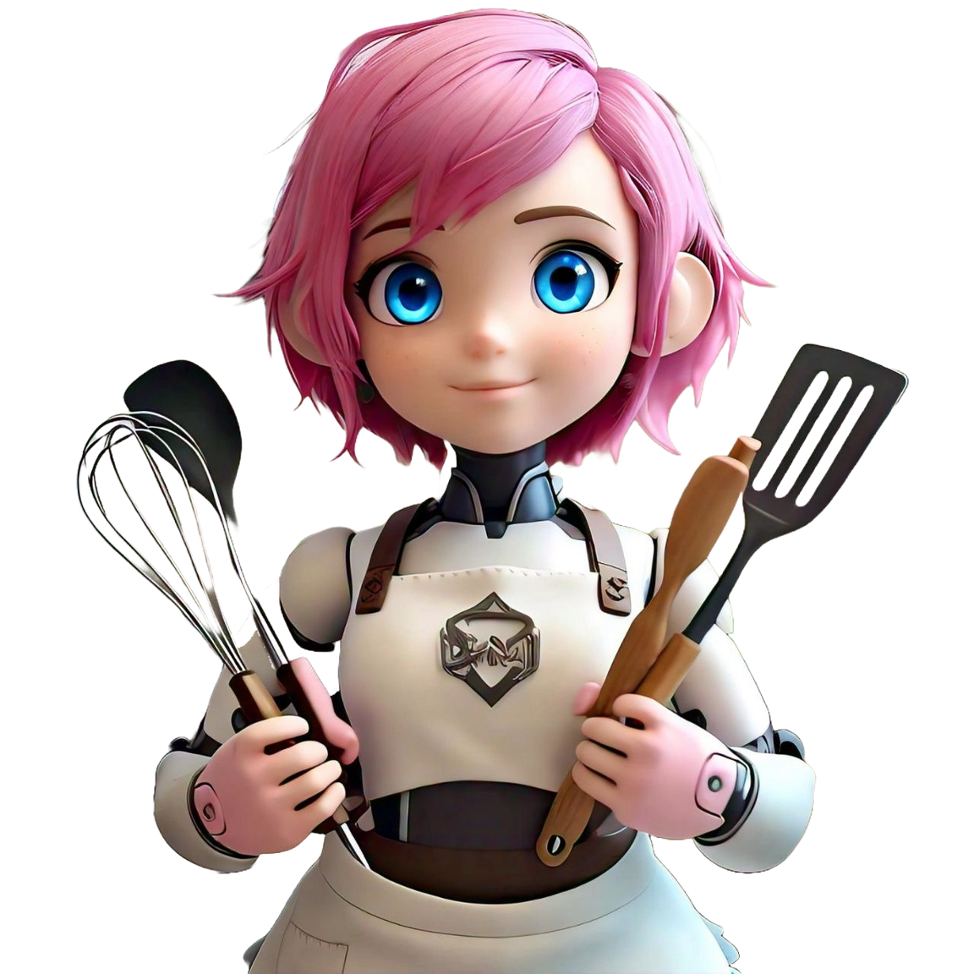


Problem Statement:
Customized AI Kitchen for INDIA
-by Kunj Bhasin

Slide 2
Solution
1. AI Model for Cooking
- Design specifications
- Training data requirements
- Initial Design
- Model Training
3. Raw Material Management
- Ingredient list generation
- Initial coding
- Integration with inventory system
- Notification System
- Testing notifications
2. Utensil Detection
- Sensor integration
- Detection algorithms
- Automation of Utensil Requests
- API Setup

Slide 3
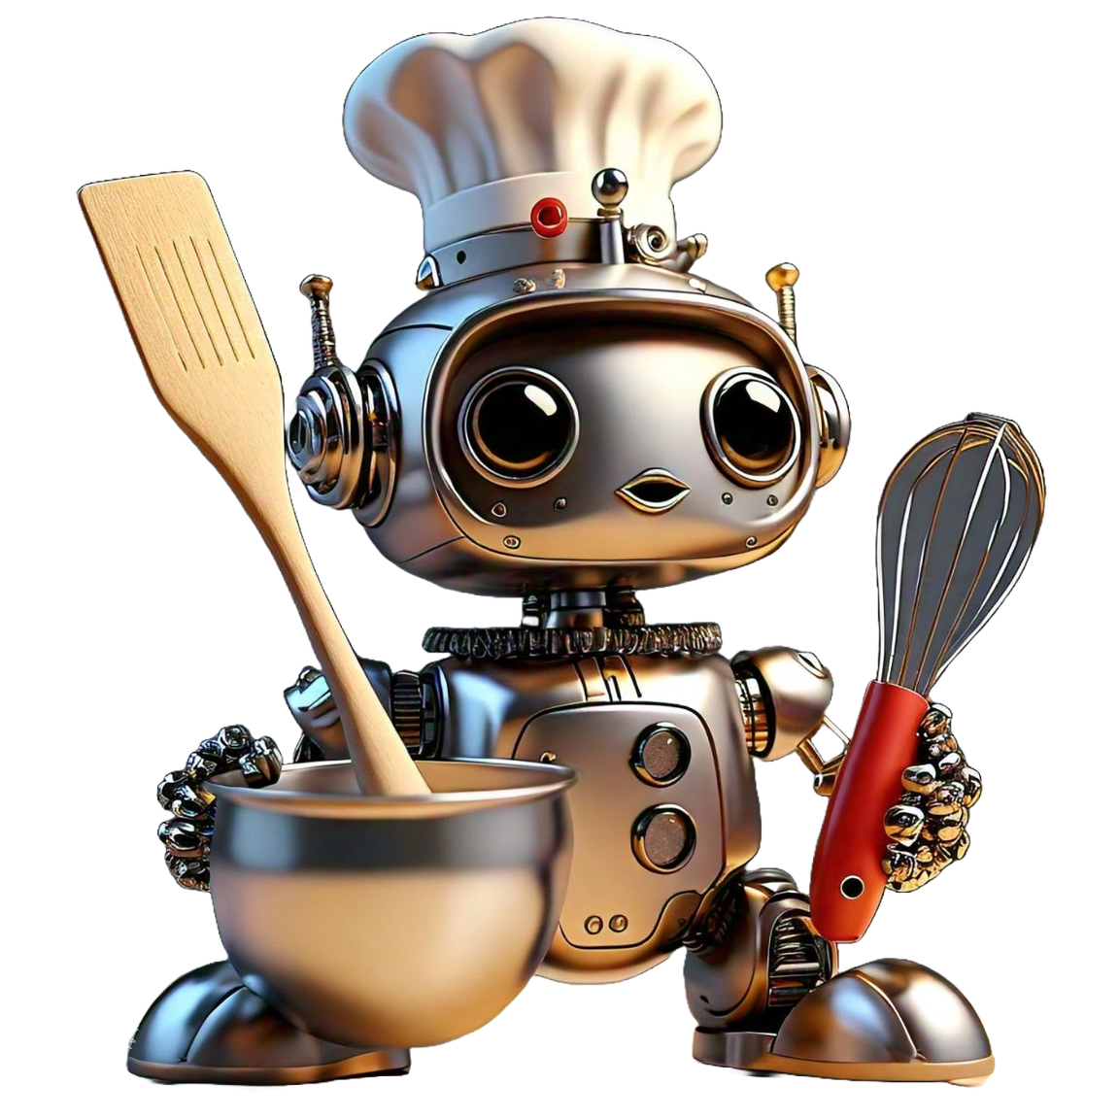
Process Flow
AI Model Development:
Collect and preprocess training data
Train Model
Start
Deploy Model
Validate Model
End

Slide 4
Process Flow
2. Utensil Detection and Management:
Integrate Sensors for detection
implement detection algorithm
Start
Deploy Automation System
Set up communication protocols
End

Slide 5
Process Flow
3. Raw Material Management:
Implement Ingredient list
Integrate with inventory system
Start
Test the system
Design Notification System
End

Slide 6
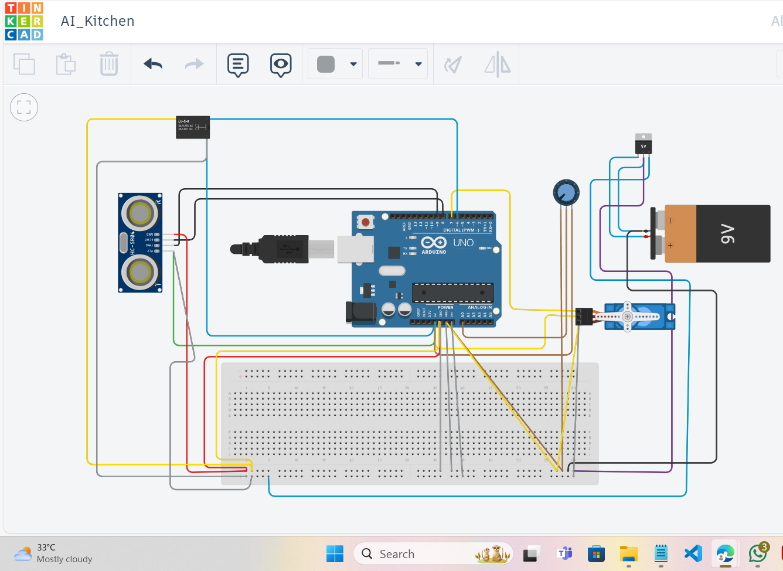
Hardware Simulation
TINKERCAD is used for simulation purpose

Slide 7
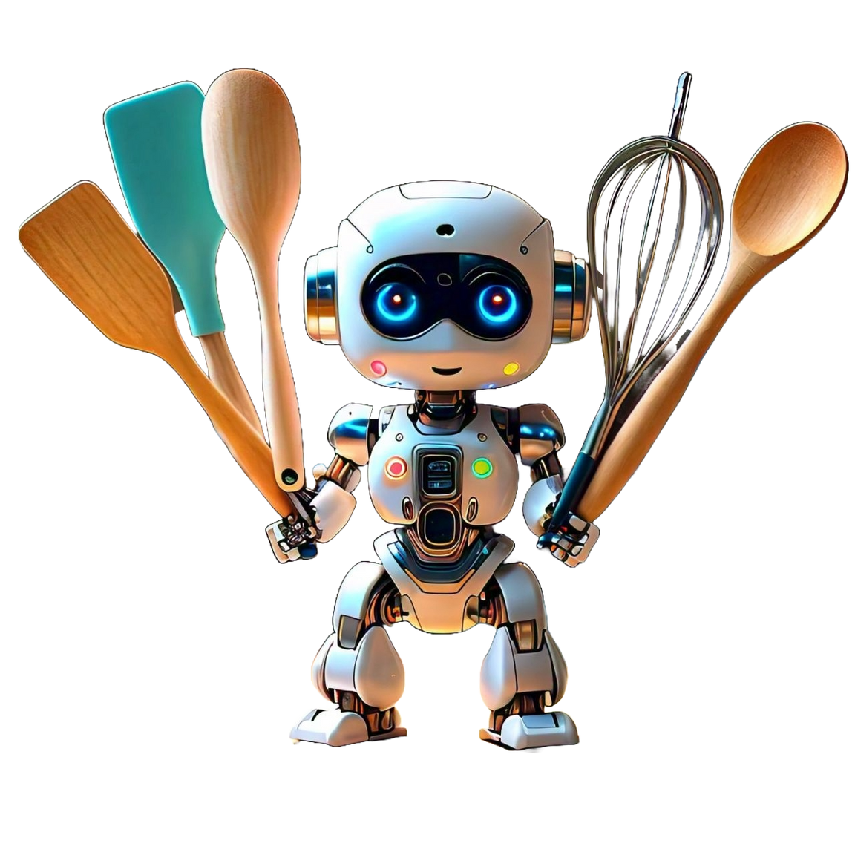
Components required for Simulation
1.Microcontroller: Arduino Uno
2. Weight Sensor: simulate it using a potentiometer
3. Proximity Sensor: HC-SR04 Ultrasonic Sensor
4. Servo Motor: Standard servo motor
5. Relay Module: Single-channel relay module
6. Additional Components: Jumper wires, breadboard, power supply

Slide 8
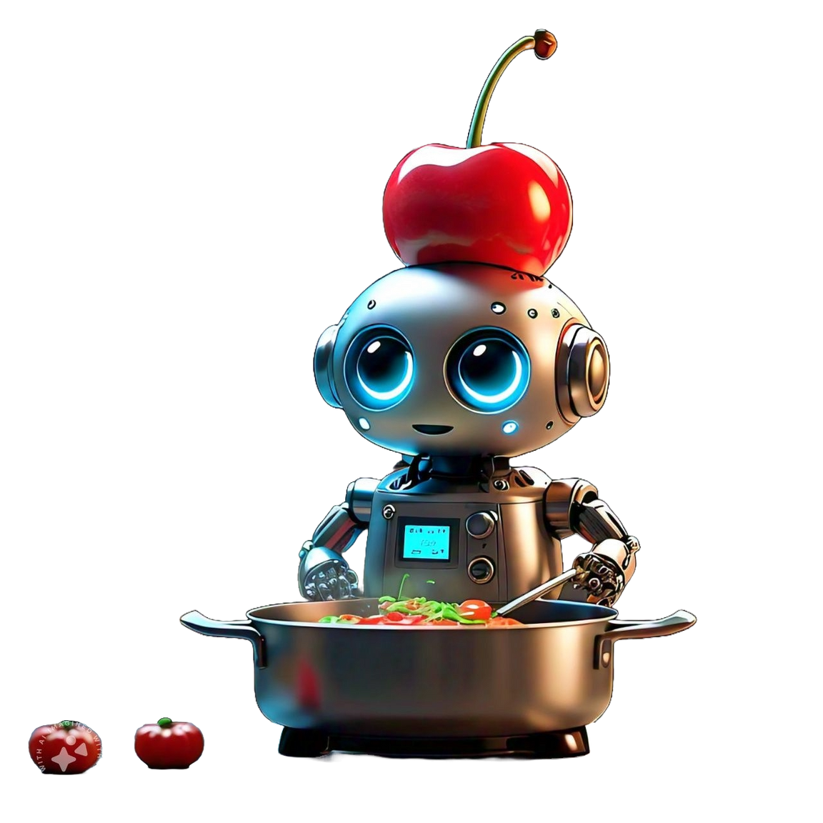
Flow Chart
1. Setup Power Supply
- Start
- Connect 9V battery to voltage regulator
- Connect voltage regulator to breadboard 5V and GND rails
- End
2. Arduino Setup
- Start
- Connect Arduino to 5V and GND rails
- Connect components (sensors, motor, relay) to Arduino
- End
3. Component Connections
- Start
- Connect proximity sensor to Arduino (VCC, GND, TRIG, ECHO)
- Connect servo motor to Arduino (VCC, GND, Signal)
- Connect relay module to Arduino (VCC, GND, IN1)
- Connect potentiometer to Arduino (VCC, GND, Signal)
- End

Slide 9







ROLE OF COMPONENTS IN AI MODEL
Arduion UNO
Potentiometer
Ultrasonic Sensor
-Acts as the control center of AI kitchen
-processing inputs from various sensors
-It is the “BRAIN” of the kitchen
-Used for measuring ingredients
-For detecting if items are placed or not
-HC-SR04 Ultrasonic Sensor
-Used to detect the presence of object

Slide 10
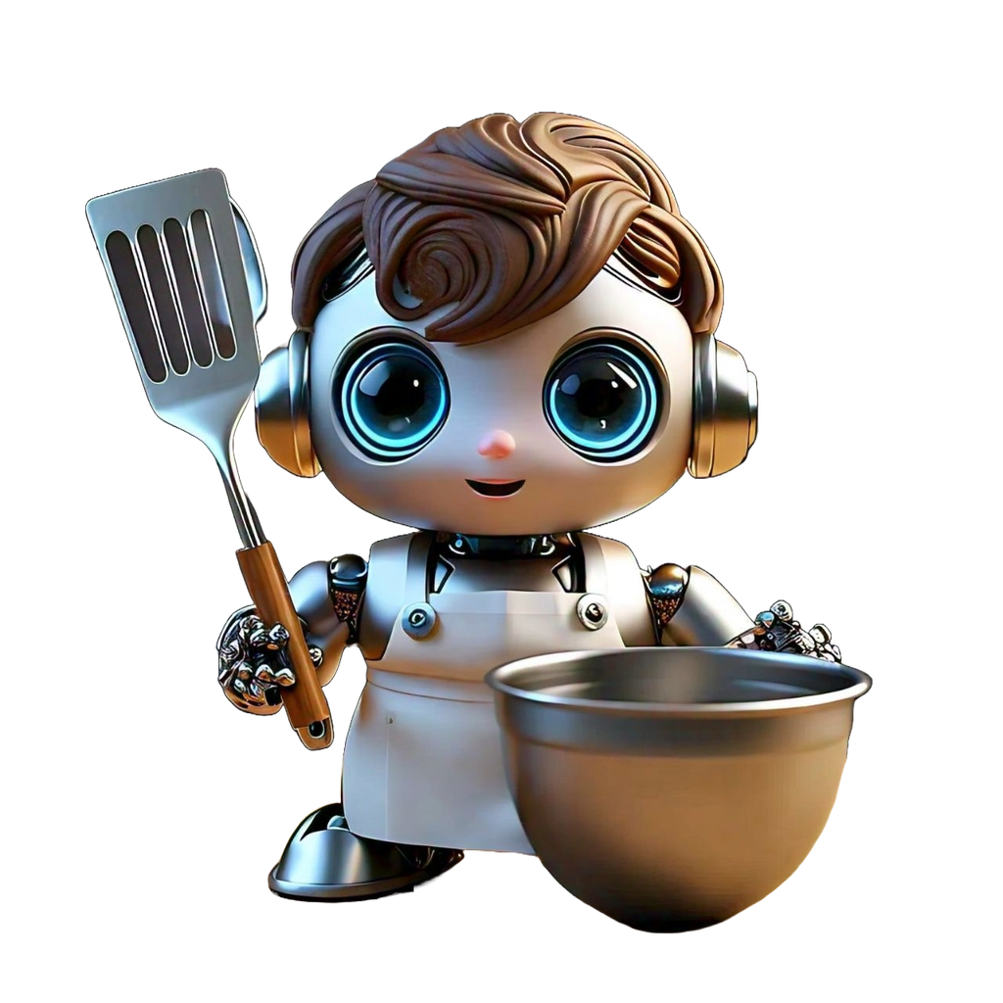

Technologies Used
1.data loading and Preprocessing
-Pandas
2. Model Building and training
-numpy
-tensorflow
-Sklearn
3. Utensil Detection and Management
opencv-python-headless
cv2.dnn(Deep neural network module in OpenCV

Slide 11
Technologies Used
4. Raw Material Management
-Pandas
5. Notification Systems
-Twilio

Slide 12
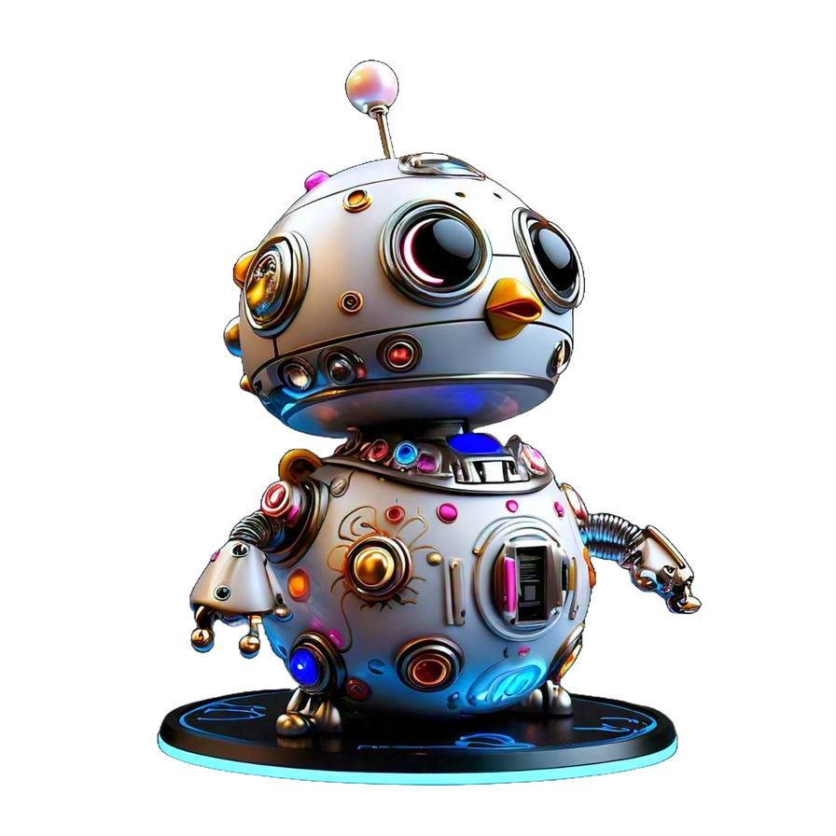
Conclusion
In conclusion, my project uses smart technology to make kitchen tasks easier and faster. Special tools like pandas, numpy, tensorflow and opencv-python-headless is used to create a syatem that can:
-Detect kitchen utensils
-Manage raw materials
-Send automated notifications
However, the notification part of our system is not working yet. Despite this, our solution still greatly improves the overall workflow in the kitchen, making it more organized and effective

Slide 13


